Slide 1

Projects Using React.js & Flux
Project 6: Stickypad Notes

Slide 2
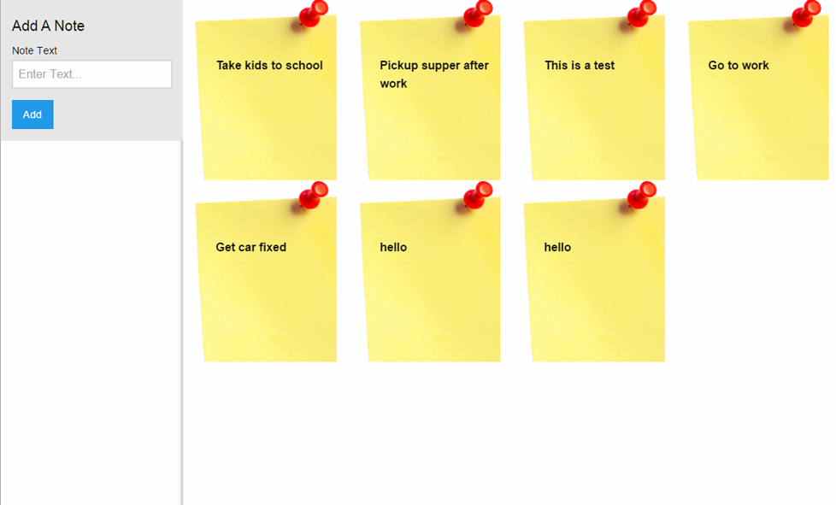
Project Description
An application where you can create simple todos or tasks on a sticky note. Data will be persisted to MongoLab

Slide 3
Project Lectures
Section Intro
Stickypad Boilerplate Setup
AddNoteForm Component
Add & Fetch Notes From MongoLab
Display StickyNotes
Delete StickyNotes

Slide 4
What You Will Learn
Create a Flux boilerplate
Create a MongoLab account & database
How to add & remove data from MongoLab
Make AJAX requests from API functions

